Slide 2
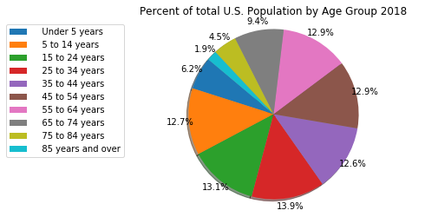
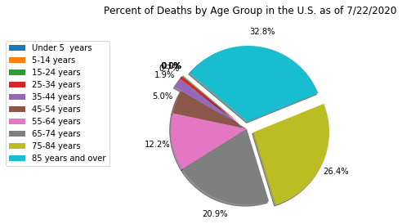
Percentage of Deaths by Age group vs. the General Population
This shows that over 59% of all deaths in the United Sates from Covid-19 were people aged 75 or older compared to the general population that represents only 6.4% of the total. Therefore, age plays a big factor in rates of death.

Slide 3
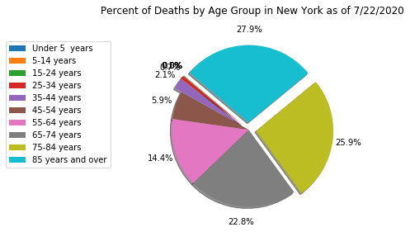
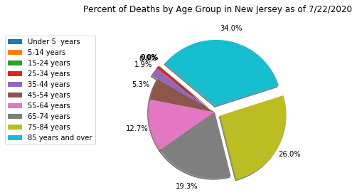
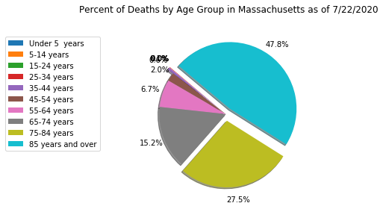
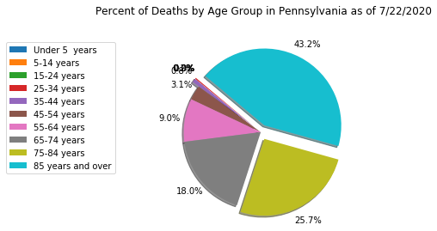
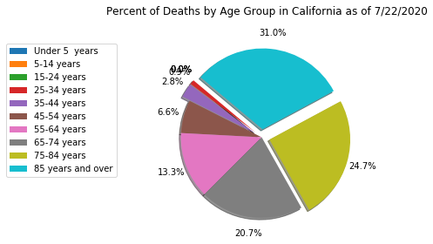
Percentage of Deaths by Age Group Highest Five States
We see that the trend is consistent. Death rates increases with age.

